Slide 1
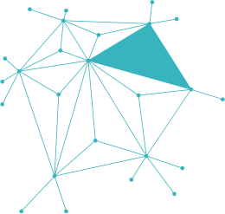

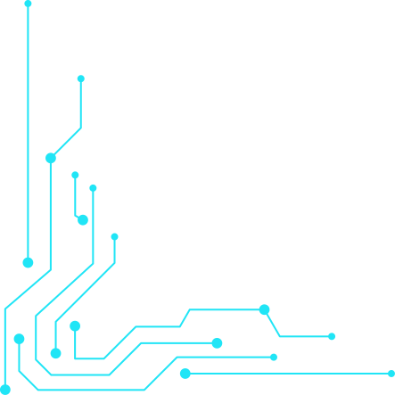

CYBER SECURITY
Outsmarting Cyber Scammers in the Digital Age
🎣 Phishing Awareness Training: Unmasked
By Zwivhuya Tshutshu | CodeAlpha Internship

Slide 2




WHAT IS PHISING?
-Phishing is a cyberattack where criminals trick you into revealing sensitive info.
-Disguised as a trusted sender (banks, IT admin, delivery service).
-Goal: steal passwords, credit cards, or personal info.
Evolution of Attack
90%

Slide 3
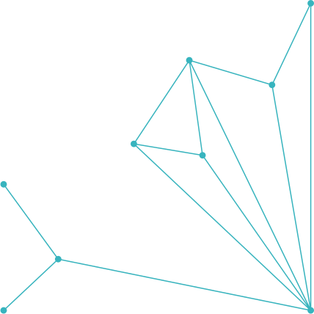
REAL-WORLD
EXAMPLE
🚨 Fake PayPal Email: “Your account will be suspended. Click here to verify.”
✅ Real PayPal Email: Professional, secure domain, no urgency.
Spot the difference:
Wrong sender domain.
Urgent/fear tone.
Suspicious link (hover reveals fake URL).
Protection
Real-Time
Secure Data
Advanced
Comprehensive
security covering
all vulnerabilities.
Continuous monitoring
to instantly neutralize
threats.
Ensure the safety of
sensitive data with
robust encryption
Protection against cyber
attacks with cutting-
edge detection.

Slide 4





Solutions
SOCIAL ENGINEERING TACTICS
24/7 Support
Round-the-clock assistance to
ensure your security.
Cybercriminala exploit human psychology:
⏰ Urgency: “Update now or lose access!”
🏢 Authority: “Message from IT Admin.”
Tailored Solutions
👀 Curiosity: “See attached invoice.”
😱 Fear: “Suspicious login attempt detected.”
Customized security strategies
for your specific needs.
Proactive Monitoring
Continuous threat detection
and prevention.

Slide 5




MODERN INFORMATION
PROTECT FROM
HACKERS
Utilizing cutting-edge encryption to
safeguard data from hackers.
Threat Detection
Firewall Defense
Security Updates

Slide 6



HOW TO SPOT PHISHING
✅ Double-check sender’s email domain.
✅ Hover over links before clicking.
✅ Look for grammar/spelling mistakes.
✅ Don’t trust unrequested attachments.
✅ Does it create fear or urgency?

Slide 7



COLUMN CHART
ANALYSIS SLIDE
Compliance Metrics
Track and analyze adherence to industry security
standards and regulations to ensure compliance.
User Awareness
Assess the effectiveness of security training programs
by measuring reductions in user-related incidents.
Diagram 01
Diagram 02
Diagram 03
Threat Sources
Identify and analyze the origins of security threats
to improve defenses and prevention strategies.

Slide 8
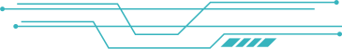





BEST
PRACTICES
🔐USE TWO-FACTOR AUTHENTICATION (2FA)
💻 Keep antivirus & filters updated.
- COVID-19 Scams: Fake vaccine registration emails targeted anxious populations.
- Bank SMS Scam: Victims received messages with fake links leading to credential theft.
🛡️ Don’t reuse passwords.
📨 Report suspicious emails to IT/security team.
- 2016 US Election: A simple spear phishing email compromised key campaign staff
- CEO Fraud: Attackers impersonated CEOs to request fraudulent wire transfers, costing companies millions

Slide 9


INTERACTIVE QUIZZES
Q2: Which is a phishing attempt?
A: support@paypa1.com → FAKE
B: support@paypal.com → REAL
Q1: What should you do first
if you suspect phishing?
Report it ✅
Q3: • Spot-the-Phish:
Analyze sample emails to identify signs of phishing.
Q4: • URL Challenge:
Decide which URLs are
genuine and which are fraudulent
Q5: • Scenario Roleplay:
Practice how to respond when your 'boss' urgently asks for sensitive information.
Q6: • • Live Phish Simulation:
Optional corporate exercise to test readiness

Slide 10
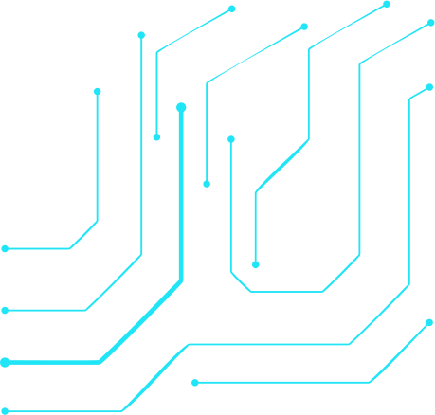
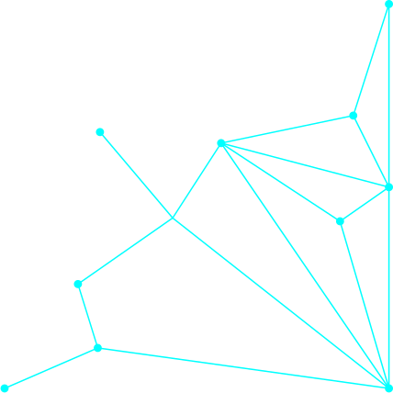
SUMMARY & TAKEAWAYS
Key Reminder:
Think Before You Click: Always pause and verify.
Verify Sources: Contact organizations using official contact information.
Resource:
Report Quickly: Immediate reporting reduces risk for everyone.
Helpful Links:
- Anti-Phishing Working Group: https://www.antiphishing.org
- Cybersecurity & Infrastructure Security Agency: https://www.cisa.gov
- Your Company Security Policy and IT Department Contact.
Use these resources to stay informed and prepared.
- Continuous Vigilance: Cyber threats evolve; stay updated on the latest tactics.

Slide 11

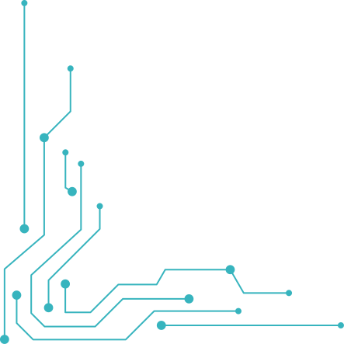


THANK YOU!!
“Trust is earned — links are verified.”
💡 Always think before you click.
CodeAlpha Cybersecurity Internship | Zwivhuya Tshutshu

